Slide 1











Physical Education Curriculum Flow
Curriculum Drivers
Aspiration
Community
Creativity
Language and communication

Slide 2
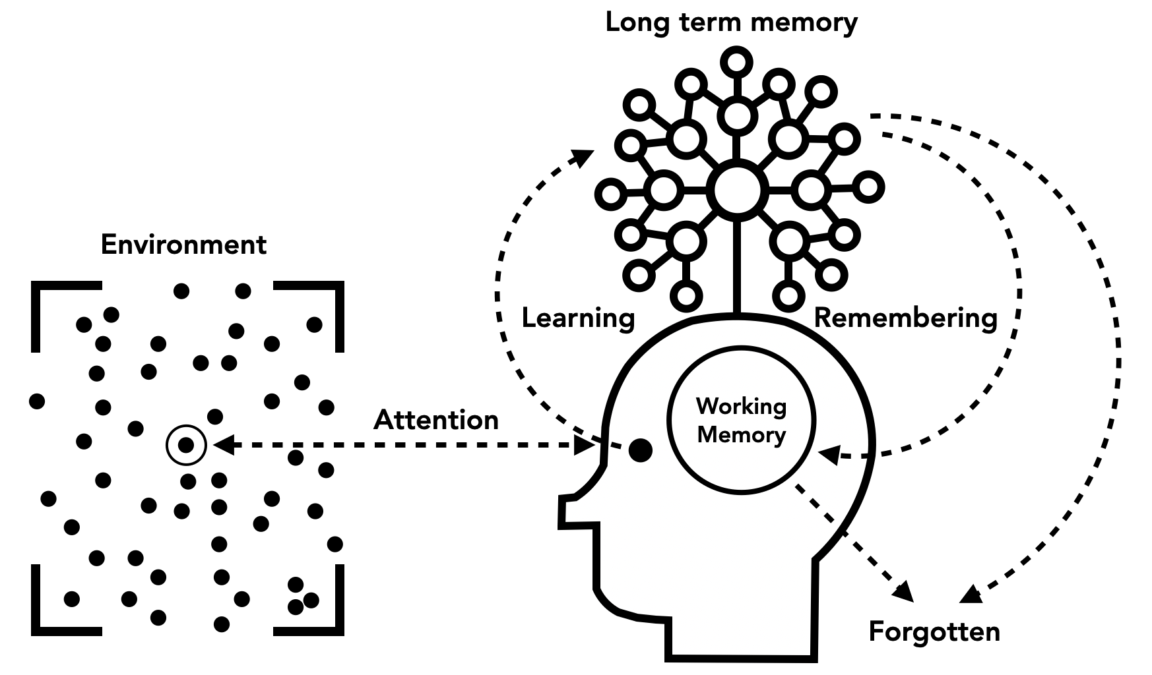
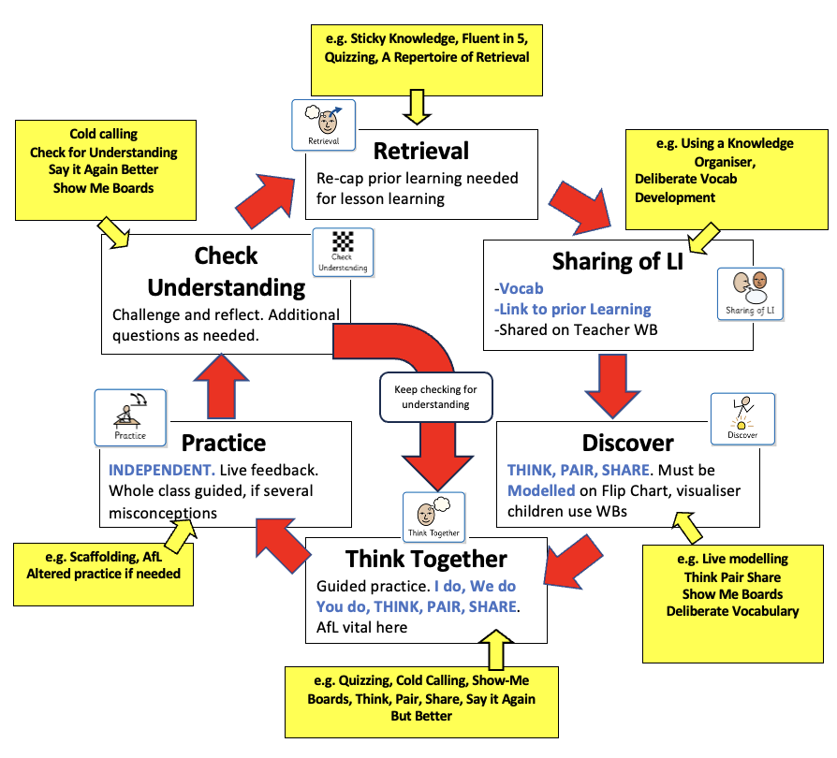
Learning model and lesson design
Curriculum Drivers
At Marden Vale we believe that our curriculum should offer not only the national curriculum but life skills and experiences beyond this. When designing our curriculum, we took into account the needs of our learners and community, our vision and values, and the location of our school. These curriculum drivers are used to underpin the development work we undertake in all areas of school life and to ensure our curriculum offer is enriched and personalised to our children and their families.
Our four key drivers are Aspiration, Community, Creativity and Language and Communication.
Tom Sherrington’s learning model underpins our teaching and learning by ensuring that lessons are well-sequenced and structured with clear learning intentions. We prioritise active student engagement, regular retrieval practice and high-quality feedback, allowing students to consolidate and retain knowledge effectively. The model supports teachers in assessing progress through formative assessment and adapting teaching to meet individual needs. A focus on delivering lessons with optimal cognitive load and promoting independent learning, helps students develop a deep understanding of the curriculum and the skills necessary for lifelong learning.

Slide 3
Children will show respect to others and sportsmanship when partaking in sport in school or outside of school.
They will experience taster days from sports clubs in the local community and beyond.
Children have the opportunity to be attend local competitions alongside other primary schools and aspire to achieve and take part in as many sporting events as possible.
Aspiration
Community
Curriculum Drivers
Creativity
Language and communication
Children are able to collaborate and communicate to enable them to work in teams as well as lead and guide others and instruct younger children as well as their peers.
Children will be exposed to and experience many differing sports which will inspire them to develop their own identity in sport.

Slide 4
Intent
Curriculum Drivers
Physical activity not only improves health, reduces stress and improves concentration, but also promotes correct physical growth and development. Exercise has a positive influence on academic achievement, emotional stability and interaction with others. Therefore, both teachers and children should be aware of the importance of physical activity. The range of physical activities is wide and includes athletics, dance, games, gymnastics, swimming and outdoor education. A high-quality programme (GetSet4PE) is used to satisfy the needs, abilities and interests of all individual children.
At Marden Vale, we aim to:
Enable children to explore and develop their physical skills.
To help establish and improve the individual child's self-esteem and confidence.
Promote a healthy and fulfilling lifestyle by developing self-motivation to take part in physical activity, both inside and outside of school.
To develop social skills (co- operating in groups, playing fairly to rules, mixing with children from other schools).
To ensure every child has the opportunity to take part in after school sports clubs, as well as external competitions and tournaments.
To provide our children with a range of skills that can be used and developed throughout their lives.
Curriculum Drivers
Implementation
• Use the Get Set 4 PE Scheme of work to support our teaching of physical activity. This includes progression from EYFS to Year 6 and a curriculum paths that allows children to revise and develop skills and techniques for physical education. .
• Ensure that children have a minimum of 2 hours of physical activity each week.
• Move daily through the use of activities such as wake and shake, the daily mile and lunch time activities run by play leaders.
• Ensure that children are able to access swimming lessons to support them in learning to swim effectively.
• Provide positive and engaging experiences to encourage a lifelong interest in physical activity.
• Provide a range of high-quality sessions with trained PE instructors throughout the year such as Up and Under, Chance to Shine and one off events.
• Involve the outside community where possible - e.g. Sports Day, Clubs, Inter-school matches.
Impact
At Marden Vale CofE Academy, we use summative assessment across the school to determine children’s knowledge, understanding and application of key skills. This assessment supports the planning, which is reviewed on a termly basis. By the end of each Key Stage, it is expected that children know and apply the skills and knowledge that has been taught in each programme of study.

Slide 5





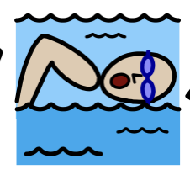





PE at Marden Vale
EYFS
KS1
KS2
Early Learning Goal: Gross Motor Skills:
Negotiate space and obstacles safely, with consideration for themselves and others,
Demonstrate strength, balance and coordination when playing,
Move energetically, such as running, jumping, dancing, hopping, skipping and climbing.
Pupils should develop fundamental movement skills, become increasingly competent and confident and access a broad range of opportunities to extend their agility, balance and coordination, individually and with others. They should be able to engage in competitive (both against self and against others) and co-operative physical activities, in a range of increasingly challenging situations.
Pupils should be taught to:
Master basic movements including running, jumping, throwing and catching, as well as developing balance, agility and co-ordination, and begin to apply these in a range of activities,
Participate in team games, developing simple tactics for attacking and defending.
Perform dances using simple movement patterns
.
Key stage 2 Pupils should continue to apply and develop a broader range of skills, learning how to use them in different ways and to link them to make actions and sequences of movement. They should enjoy communicating, collaborating and competing with each other. They should develop an understanding of how to improve in different physical activities and sports and learn how to evaluate and recognise their own success.
Pupils should be taught to:
Use running, jumping, throwing and catching in isolation and in combination,
Play competitive games, modified where appropriate [for example, badminton, basketball, cricket, football, hockey, netball, rounders and tennis], and apply basic principles suitable for attacking and defending.
Develop flexibility, strength, technique, control and balance [for example, through athletics and gymnastics].
Perform dances using a range of movement patterns.
Take part in outdoor and adventurous activity challenges both individually and within a team.
Compare their performances with previous ones and demonstrate improvement to achieve their personal best.
.
Early learning goals and National Curriculum
All schools must provide swimming instruction either in key stage 1 or key stage 2.
In particular, pupils should be taught to:
Swim competently, confidently and proficiently over a distance of at least 25 metres.
Use a range of strokes effectively [for example, front crawl, backstroke and breaststroke].
Perform safe self-rescue in different water-based situations.
Swimming
Our Big Ideas
that link the learning
Fundamentals
(ABCs, athletics)
Dance
Games
Body Management
(gymnastics and yoga)
OAA
Swimming
SCHEME (Get Set for PE) Programme
Second Order Concepts
Healthy, active lifestyle
Competence
Performance
Creativity
Evaluation and analysis

Slide 6
Our Big Ideas
F.M.S.
(Fundamental Movement Skills)
Through fundamentals, athletics and fitness master basic movements (running, jumping and throwing) as well as developing agility, balance and co-ordination
Games
Master basic movements of throwing and catching and apply to team games where tactics for attacking and defending are seen
Dance
Making simple movement patterns or a range of movement patterns that lead to performances
Body Management
Through gymnastics and yoga master basic moments and develop agility, balance and co-ordination leading to development of flexibility, strength, technique, control and balance.
OAA
(Outdoor and Adventurous Activity)
Participate in team games and take part in outdoor adventurous activity individually and in a team
Swimming
Develop swimming skills to swim efficiently as well as develop water safety knowledge and skills

Slide 7






Key Concept Images
Art Curriculum Overview
Physical Education Curriculum Overview
 | Term 1 | Term 2 | Term 3 | Term 4 | Term 5 | Term 6
EYFS | Introduction to PE Unit 1 Fundamentals: Fundamentals Unit 1 | Introduction to PE Unit 2 Fundamentals: Fundamentals Unit 2 | Dance: Unit 1 Body Management: Gymnastics Unit 1 | Games: Ball skills Unit 1 Body Management: Gymnastics Unit 2 | Games: Ball skills Unit 2 Dance: Unit 2 | Games: Games Unit 1 Fundamentals: Sports Day skills
Year 1 | OAA: Team Building Fundamentals: Fundamentals | Dance: Dance Unit 1 Body Management: Gymnastics Unit 1 | Body Management: Yoga Fundamentals: Fitness | Games: Ball skills Dance: Dance: Unit 2 | Fundamentals: Athletics Games: Target Games | Games: Sending and receiving Games: Invasion games
Year 2 | OAA: Team Building Fundamentals: Fundamentals | Dance: Dance Unit 1 Body Management: Gymnastics Unit 1 | Body Management: Yoga Fundamentals: Fitness | Games: Ball skills Body Management: Gymnastics Unit 1 | Fundamentals: Athletics Games: Target Games | Games: Sending and receiving Games: Invasion games
Year 3 | Fundamentals: Fundamentals Y3/4 Games: Ball skills Y3/4 | Body Management: Yoga Games: Dodgeball | Games: Football Dance: Dance Y3 | Body Management: Gymnastics Games: Cricket (Chance to Shine) | Fundamentals: Athletics Games: Basketball | Games: Rounders Games: Golf
Year 4 | Fundamentals: Fitness Games: Tag Rugby | OAA: Orienteering Games: Handball | Games: Football Dance: Dance Block 1 | Body Management: Gymnastics Games: Cricket (Chance to Shine) | Fundamentals: Athletics Dance: Dance Block 2 | Games: Tennis Games: Rounders
Year 5 | Swimming Games: Badminton Y5/6 | Body Management:: Yoga Games: Dodgeball | Games: Hockey Dance: Dance Block 1 | Body Management: Gymnastics Games: Cricket (Chance to Shine) | Fundamentals: Athletics Dance: Dance Block 2 | Games: Rounders Games: Rounders
Year 6 | Fundamentals: Fitness Games: Tag Rugby | OAA: Orienteering Dance: Dance Block 1 | Games: Hockey Body Management: Gymnastics | Gamet: Volleyball Y5/6 Games: Cricket (Chance to Shine) | Games: Netball Fundamentals: Athletics | Games: Tennis Swimming

Slide 8
Physical Education at Marden Vale
Year 5
Year 1
Year 3
Gymnastics Unit 2
Dance Unit 2
Gymnastics Unit 1
Ball skills Unit 1
Team Building
Fundamentals
Dance
Gymnastics
Invasion Games
Sending and Receiving
Target Games
Athletics
Fundamentals
Ball Skills
Yoga
Dodgeball
Golf
Rounders
Basketball
Athletics
Swimming
Badminton
Yoga
Dodgeball
Swimming
Tennis
Athletics
Netballl
Ball skills Unit 2
Fundamentals
Games Unit 1
Dance Unit 1
Yoga
Fitness
Ball Skills
Dance
Gymnastics
Ball Skills
Fitness
Yoga
Football
Dance
Gymnastics
Cricket - Chance To Shine
Cricket Chance to Shine
Gymnastics
Dance
Football
Hockey
Dance
Gymnastics
Cricket - Chance to Shine
Cricket - Chance to Shine
Volleyball
Gymnastics
Hockey
Fundamentals Unit 2
Introduction to PE Unit 2
Fundamentals Unit 1
Introduction to PE Unit 1
Athletics
Target Games
Sending and Receiving
Invasion Games
Gymnastics
Dance
Fundamentals
Team Building
Athletics
Basketball
Rounders
Golf
Handball
Orienteering
Tag Rugby
Fitness
Athletics
Dance
Rounders
Netball
Dance
Orienteering
Fitness
Tag Rugby
Year 2
Year 4
Year 6
EYFS

Slide 9
Our second order concepts shape the questions we ask
Healthy, active lifestyle
Understanding the positive contribution that regular, fit for purpose physical activity makes to the physical and mental health of the individual in preparation for their future lives
Competence
The selection and application of skills, tactics and compositional ideas. The readiness of body and mind to cope with physical activity.
Performance
Using physical competence and knowledge to gain a better understanding of physical activity.
Creativity
Exploring and experimenting with techniques, tactics and compositional ideas to produce efficient and effective outcomes.
Evaluation and analysis
Comparing performance with previous ones and those of others to demonstrate improvement to achieve their personal best

Slide 10
Our second order concepts shape the questions we ask
Healthy, active lifestyle
How does exercise help with a healthy lifestyle?
How does my body feel during exercise?
Competence
Which tactics do I need to apply to this game?
Which skills do I need to apply to this game?
Performance
How can I improve my performance?
Which skills doI need to practice to get better?
Creativity
How can I beat the defender?
How can I defend?
What can my team and I do to try and win the game?
Evaluation and analysis
How will I know if my performance has improved?
What are the strengths of my team?

