Slide 1

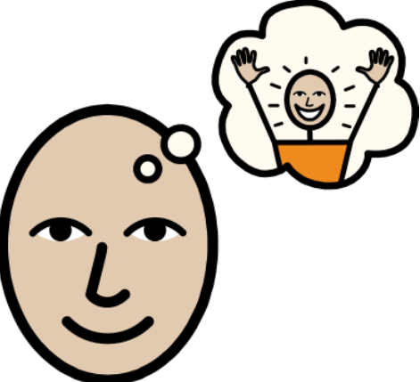


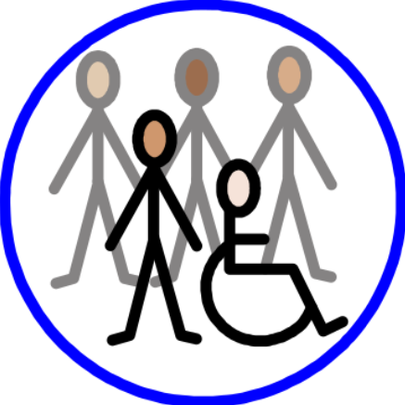


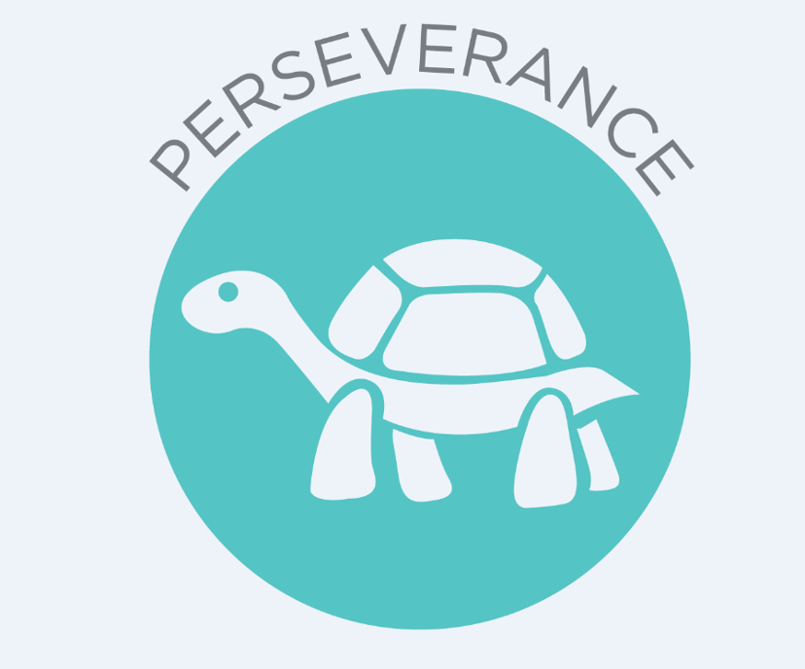



Design Technology Curriculum Flow
Curriculum Drivers
Aspiration
Community
Creativity
Language and communication

Slide 2
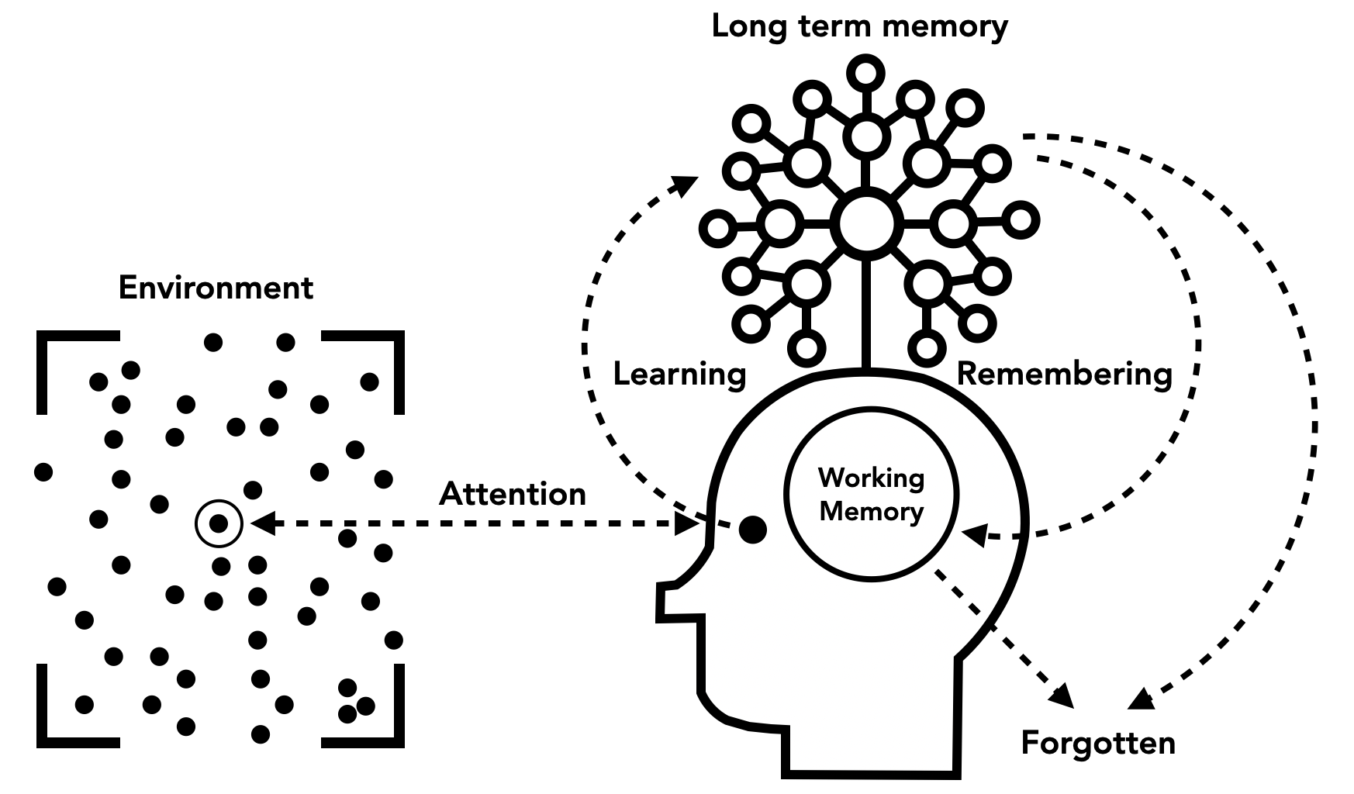
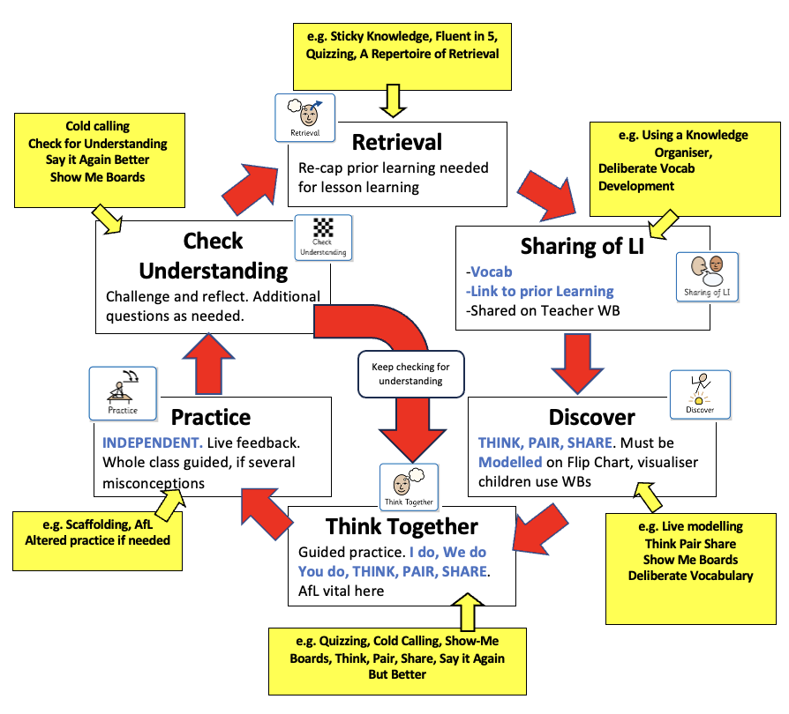
Learning model and lesson design
Curriculum Drivers
At Marden Vale we believe that our curriculum should offer not only the national curriculum but life skills and experiences beyond this. When designing our curriculum, we took into account the needs of our learners and community, our vision and values, and the location of our school. These curriculum drivers are used to underpin the development work we undertake in all areas of school life and to ensure our curriculum offer is enriched and personalised to our children and their families.
Our four key drivers are Aspiration, Community, Creativity and Language and Communication.
Tom Sherrington’s learning model underpins our teaching and learning by ensuring that lessons are well-sequenced and structured with clear learning intentions. We prioritise active student engagement, regular retrieval practice and high-quality feedback, allowing students to consolidate and retain knowledge effectively. The model supports teachers in assessing progress through formative assessment and adapting teaching to meet individual needs. A focus on delivering lessons with optimal cognitive load and promoting independent learning, helps students develop a deep understanding of the curriculum and the skills necessary for lifelong learning.

Slide 3
Aspiration
Community
Providing opportunities to explore the purpose of design out in the community, Develops discussion and interaction and reflects the whole community values. It allows children the opportunity to work with and appraise each other’s work.
Curriculum Drivers
Providing children with ideas, inspiration and confidence to work through the creative process to design and create an end product.
Creativity
Providing a broad and balanced DT curriculum that is reflective of the changes in design and purpose of design. Enable children to feel confident in the experimentation of design from exploring the work of designers from a wide range of designing purposes.
Language and communication
Enabling children to have the understanding and vocabulary to express ideas and understand the propose behind the activities that they are presented with.

Slide 4
Curriculum Drivers
Intent:
At Marden Vale, the intent of our Design Technology curriculum is to design a curriculum, which is inclusive to all learners through planning a progressing scheme that will support and build on previously acquired knowledge and skills. Children will know more, remember more and understand more. Our school vision and curriculum drivers underpin this.
As a school we use Kapow to support our teaching of Design Technology. This scheme of work aims to inspire pupils to be innovation and creative thinkers who have an appreciation for the product design cycle through the formation of ideas,, creation and evaluation whilst developing their technical skills. We want pupils to develop the confidence to take risks through drafting design concepts, modelling, and testing and to be reflective learners, who evaluate their work and the work of others.
Our Design Technology progression allows the children to experience design, making, evaluating and technical knowledge through the concepts of: textiles, structures, cooking and nutrition,, mechanisms, digital world (KS2 only) and electrical systems (KS2 only).
Curriculum Drivers
Implementation
In EYFS our DT curriculum stems from the ELGs and the opportunities we provide to our foundation stage children. In EYFS the children have plenty of opportunities to explore materials and the world around them. They begin to use a range of tools as part of their physical development. Children start to understand the design and make process.
From KS1 the Design and Technology national curriculum outlines the three main stages of the design process: design, make and evaluate (along with technical skills). Each stage of the design process is underpinned by technical knowledge which encompasses the contextual and technical understanding required for each strand. Cooking and nutrition has a separate section, with a focus on specific principles, skills and techniques in food, including where food comes from, diet and seasonality.
By using Kapow we are following a spiral curriculum so that key areas are visited again and again, with increased complexity, allowing pupils to revisit and build on their previous learning.
DT is taught bi-termly focusing on the DT project that term either weekly, in blocks or through DT days.. Additional concepts are taught through DT days.
By organising DT this way in allows pupils to experience the whole design process from start to finish. The lessons incorporate a range of teaching strategies from independent tasks, paired and group work, including hands-on, computer based and inventive tasks. Knowledge organisers are used for each unit to support pupils in building a foundation of factual knowledge by encouraging recall of key facts and vocabulary. A range of skills will be taught ensuring that children are aware of health and safety issues related to the tasks undertaken.
Evidence of DT learning is collated in DT folders.. There are opportunities for wider application of DT including after-school clubs and planned opportunities across the curriculum.
Impact
The impact of our curriculum is monitored through unit entry and unit exit quizzes as well as evaluations of final products. Teachers will assess through the knowledge stated in the unit overviews and the knowledge organiser for the project.

Slide 5
Design Technology at Marden Vale
KS1
Design purposeful, functional, appealing products for themselves and other users based on design criteria
Generate, develop, model and communicate their ideas through talking, drawing, templates, mock-ups and, where appropriate, information and communication technology
Select from and use a range of tools and equipment to perform practical tasks [for example, cutting, shaping, joining and finishing]
Select from and use a wide range of materials and components, including construction materials, textiles and ingredients, according to their characteristics
Explore and evaluate a range of existing products
Evaluate their ideas and products against design criteria
Build structures, exploring how they can be made stronger, stiffer and more stable
Explore and use mechanisms [for example, levers, sliders, wheels and axles], in their products
Use the basic principles of a healthy and varied diet to prepare dishes
Understand where food comes from.
KS2
Use research and develop design criteria to inform the design of innovative, functional, appealing products that are fit for purpose, aimed at particular individuals or groups
Generate, develop, model and communicate their ideas through discussion, annotated sketches, cross-sectional and exploded diagrams, prototypes, pattern pieces and computer-aided design
Select from and use a wider range of tools and equipment to perform practical tasks [for example, cutting, shaping, joining and finishing], accurately
Select from and use a wider range of materials and components, including construction materials, textiles and ingredients, according to their functional properties and aesthetic qualities
Investigate and analyse a range of existing products
Evaluate their ideas and products against their own design criteria and consider the views of others to improve their work
Understand how key events and individuals in design and technology have helped shape the world
Apply their understanding of how to strengthen, stiffen and reinforce more complex structures
Understand and use mechanical systems in their products [for example, gears, pulleys, cams, levers and linkages]
Understand and use electrical systems in their products [for example, series circuits incorporating switches, bulbs, buzzers and motors]
Apply their understanding of computing to program, monitor and control their products.
Understand and apply the principles of a healthy and varied diet
Prepare and cook a variety of predominantly savoury dishes using a range of cooking techniques
Understand seasonality, and know where and how a variety of ingredients are grown, reared, caught and processed.
EYFS
Expressive Arts & Design: Creating with Materials
Safely use & explore a variety of materials, tools & techniques, experimenting with colour, design, texture, form & function
Share their creations, explaining the process they used.
Early learning goals and National Curriculum
Textiles
Structures
Cooking and Nutrition
Our Big Ideas
that link the learning
Mechanisms and mechanical systems
Digital World
Electrical systems
KAPOW Programme
Second Order Concepts
Design
Make
Evaluate
Technical skills

Slide 6






Our Big Ideas
Textiles
Fastening, sewing, decorative
and functional fabric
techniques including
cross stitch, blanket
stitch and appliqué.
Cooking and nutrition
Where food comes from,
balanced diet, preparation
and cooking skills. Kitchen
hygiene and safety. Following
recipes.
Structures
Material functional and
aesthetic properties,
strength and stability,
stiffen and reinforce
structures.
Mechanisms and mechanical systems
Mimic natural movements
using mechanisms such as
cams, followers, levers and
sliders.
Electrical systems
Operational series circuits,
circuit components, circuit
diagrams and symbols,
combined to create various
electrical products.
Digital world
Program products to monitor
and control, develop designs
and virtual models using 2D
and 3D CAD software.

Slide 7






Key Concept Images
Design Technology Curriculum Overview
 | Term 1 | Term 2 | Term 3 | Term 4 | Term 5 | Term 6 | Additional units to be taught through the year | Additional units to be taught through the year | Additional units to be taught through the year
EYFS |  | Textiles: Bookmarks |  | Structures: Junk modelling/Boats |  | Cooking and Nutrition: Soup* completed in Term 1
Year 1 |  | Textiles: Puppets |  | Structures: Constructing windmills |  | Cooking and Nutrition: Smoothies | Mechanisms: Wheels and axels
Year 2 |  | Textiles: Pouches |  | Structures: Baby bear’s chair |  | Cooking and Nutrition: Balanced diet (wraps) | Mechanisms: Fairground wheel
Year 3 |  | Textiles: Cross stitch and appliqué |  | Structures: Constructing a castle |  | Cooking and Nutrition: Eating seasonally (seasonal tart) | Mechanisms and mechanical structures: Mechanical cars | Digital world: Wearable technology
Year 4 |  | Textiles: Fastenings (book cover) |  | Structures: Pavilions |  | Cooking and Nutrition: Adapting a recipe | Mechanisms and mechanical structures: Making a slingshot car |  | Electrical systems: Torches
Year 5 |  | Textiles: Stuffed toys |  | Structures: Bridges |  | Cooking and Nutrition: Developing a recipe | Mechanisms and mechanical structures: Making a pop up book |  | Electrical systems: Doodlers
Year 6 |  | Textiles: Waistcoats |  | Structures: Playgrounds |  | Cooking and Nutrition: Come dine with me (Main course) |  | Digital world: Navigating the world

Slide 8
Design Technology at Marden Vale
Year 1
Year 3
Year 5
Soup*
Puppets
Balanced diet
Cross stitch and appliqué
Adapting a recipe
Stuffed toys
Come dine with me
Junk modelling and Boats
Windmills
Baby bear’s chair
Constructing a castle
Pavilions
Bridges
Playgrounds
Bookmarks
Smoothies
Pouches
Eating seasonally
Fastenings
Developing a recipe
Waistcoats
Year 2
Year 4
Year 6
EYFS

Slide 9




Our second order concepts shape the questions we ask
Technical skills
Technical skills are sets of abilities or knowledge used to perform practical tasks in technology,
Design
To decide upon the look and functioning of (a building, garment, or other object), by making a detailed drawing of it and thinking about the way it functions.
Make
To form something by putting the parts together.
Evaluate
To look at an object in a careful and thoughtful way to judge its effectiveness.

Slide 10
Our second order concepts shape the questions we ask
Design
What is the purpose of my product?
What materials will I need?
How will I join materials?
Who is my product for?
Make
How will I join materials?
How will I cut my materials?
What tools will I need?
How big/ small will my design be?
Evaluate
Have I followed my design?
What worked well?
What could be improved?
What would I change?
Did my design fit the purpose? effectiveness.
Technical skills
What skill was important?
How will I create a mechanism?
How did I join my fabric?
What skills do I need for this big idea?

